Slide 1








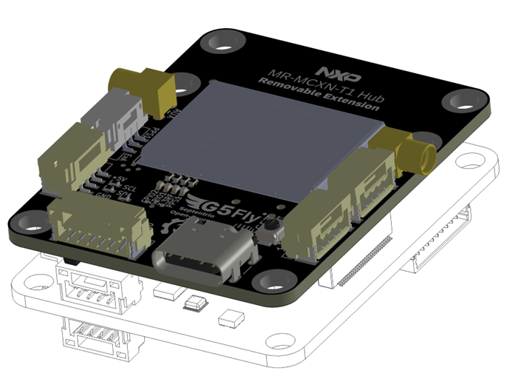
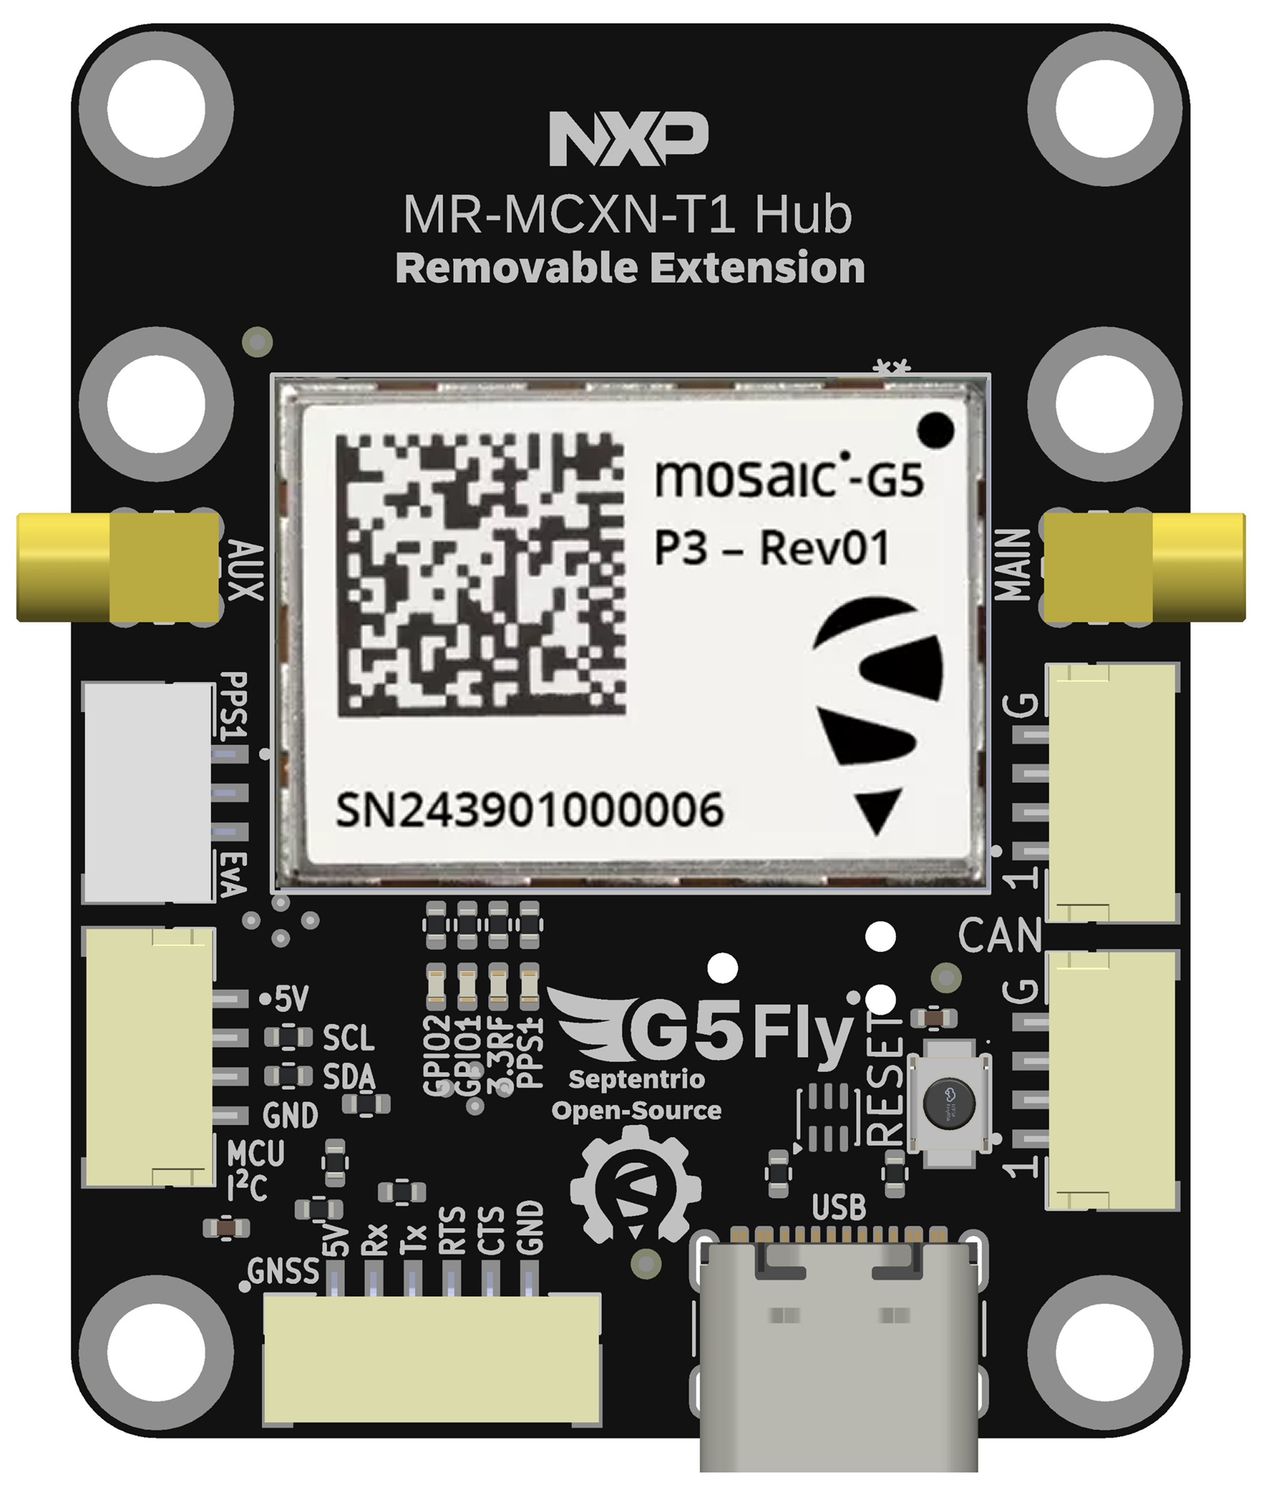
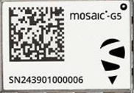
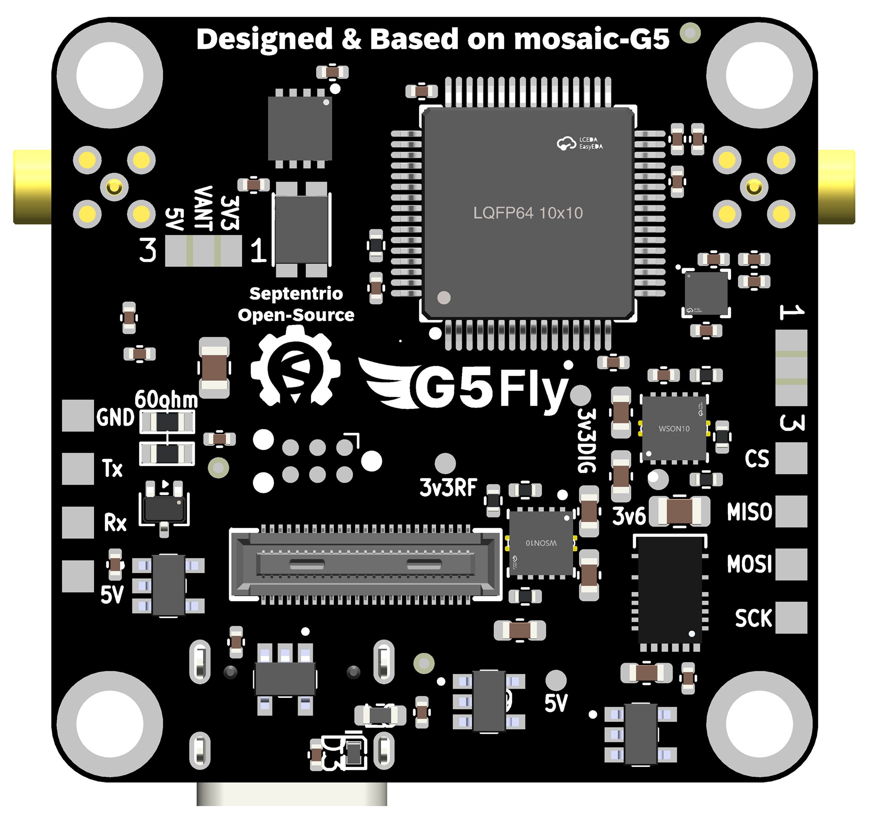
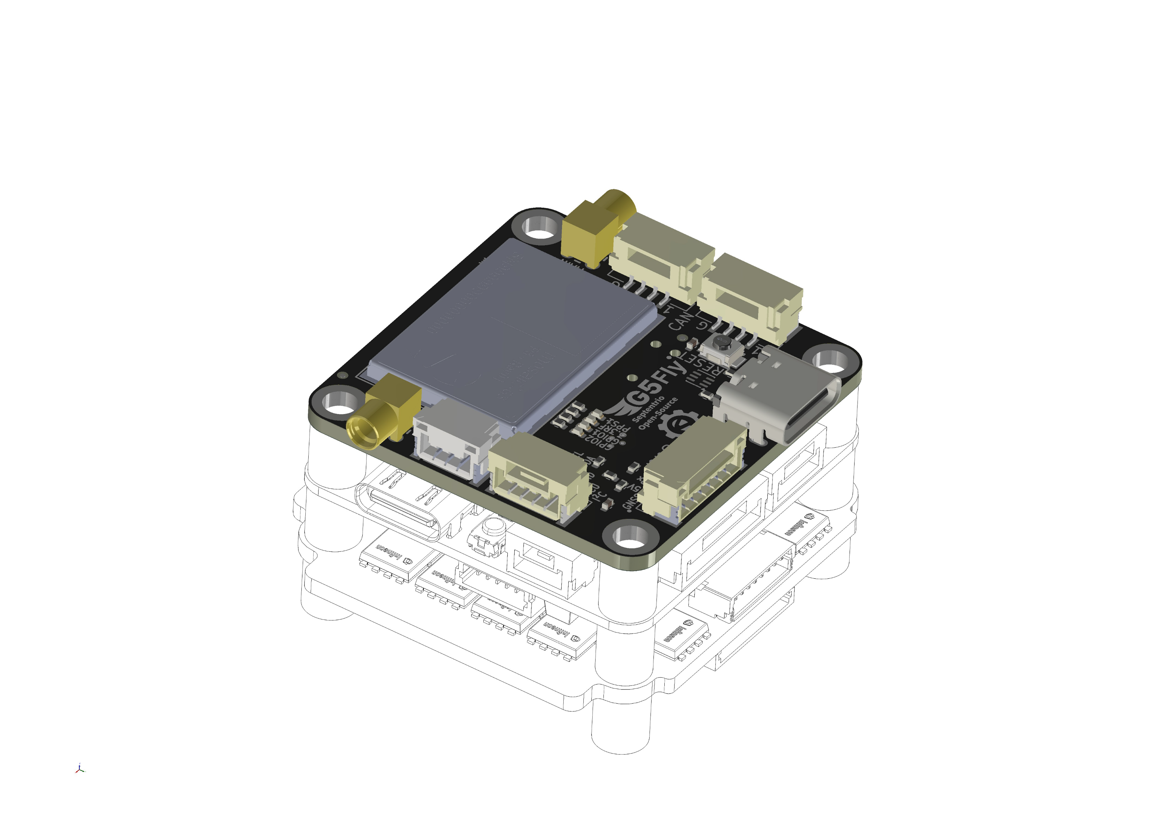
DroneCan
Magnetometer
G5Fly is an open-source board design based on the “FPV flight controller” form factor (30.5 × 30.5 mm), with an extended version (30.5 × 40 mm). It is suitable for a wide range of applications including robotics, UAVs, and industrial embedded systems.
1
1
2
6
N° | Type | Device | Connectors
1 | Antenna | G5 P3(H) | MMCX male plug
2 | PPS/EVENT | G5 P3(H) | JST 3 pin / DF40
3 | I²C 1 | NXP MCU() [I²C 1] | JST 4 pin
4 | UART (RTS/CTS) G5 | G5 P3(H) [UART 2 – shared with interface 8] | JST 6 pin / DF40
5 | USB-2.0 | G5 P3(H) | USB-C
6 | CAN 11 | NXP MCU + Transceiver (TJA1462ATK) | x2 JST 4 pin
7 | SPI1 | Magnetometer STM (LIS2MDLTR) | x4 Solder pads
8 | UART (RTS/CTS) G5 + PPS/EVENT1 | G5 P3(H) [UART 2 – shared with interface 3 and 4] | DF40 / JST 6 pin + JST 3 pin
9 | UART NXP | NXP MCU [UART 2] | x4 Solder pads
* | UART G5 | G5 P3(H) [UART 1] <-> NXP [USART 1] | Internal connection
3
6
MR-MCXN-T1 Hub
4
5
7
9
8
1 Optional at assembly
The board integrates the high-precision and resilient Mosaic-G5 P3(H), P6 or P8 module, delivering accurate positioning even in challenging environments.
An optional dual-antenna configuration enables precise heading output.
Any flight controller (30.5 x 30.5 mm)

